Slide 1
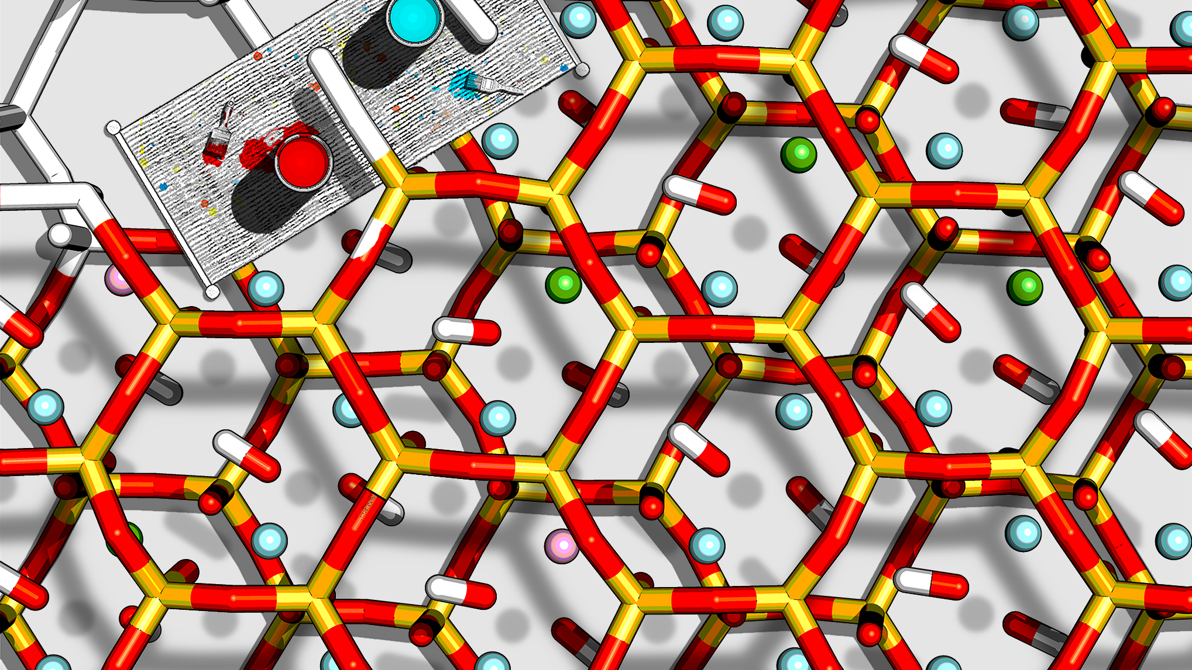
Computational Techniques in Chemistry
Session 3:
Molecular simulation of a layered materials system
Valentina Erastova
University of Edinburgh
January 2025
Big thanks to Matteo Degiacomi (matteo.degiacomi@ed.ac.uk) and Hannah Pollak (h.pollak@sms.ed.ac.uk for material development

Slide 2
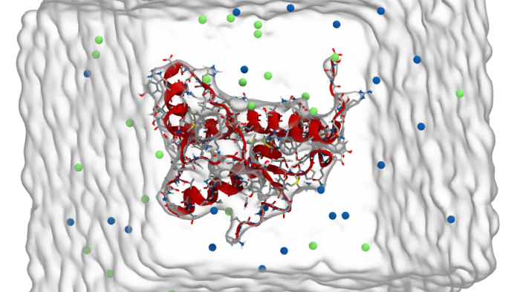
RECAP

Slide 3
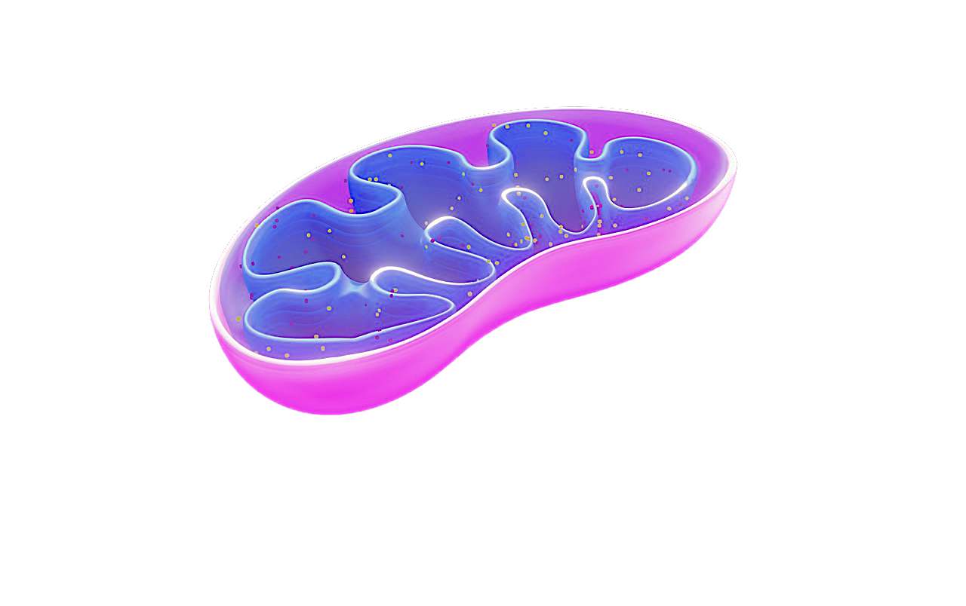
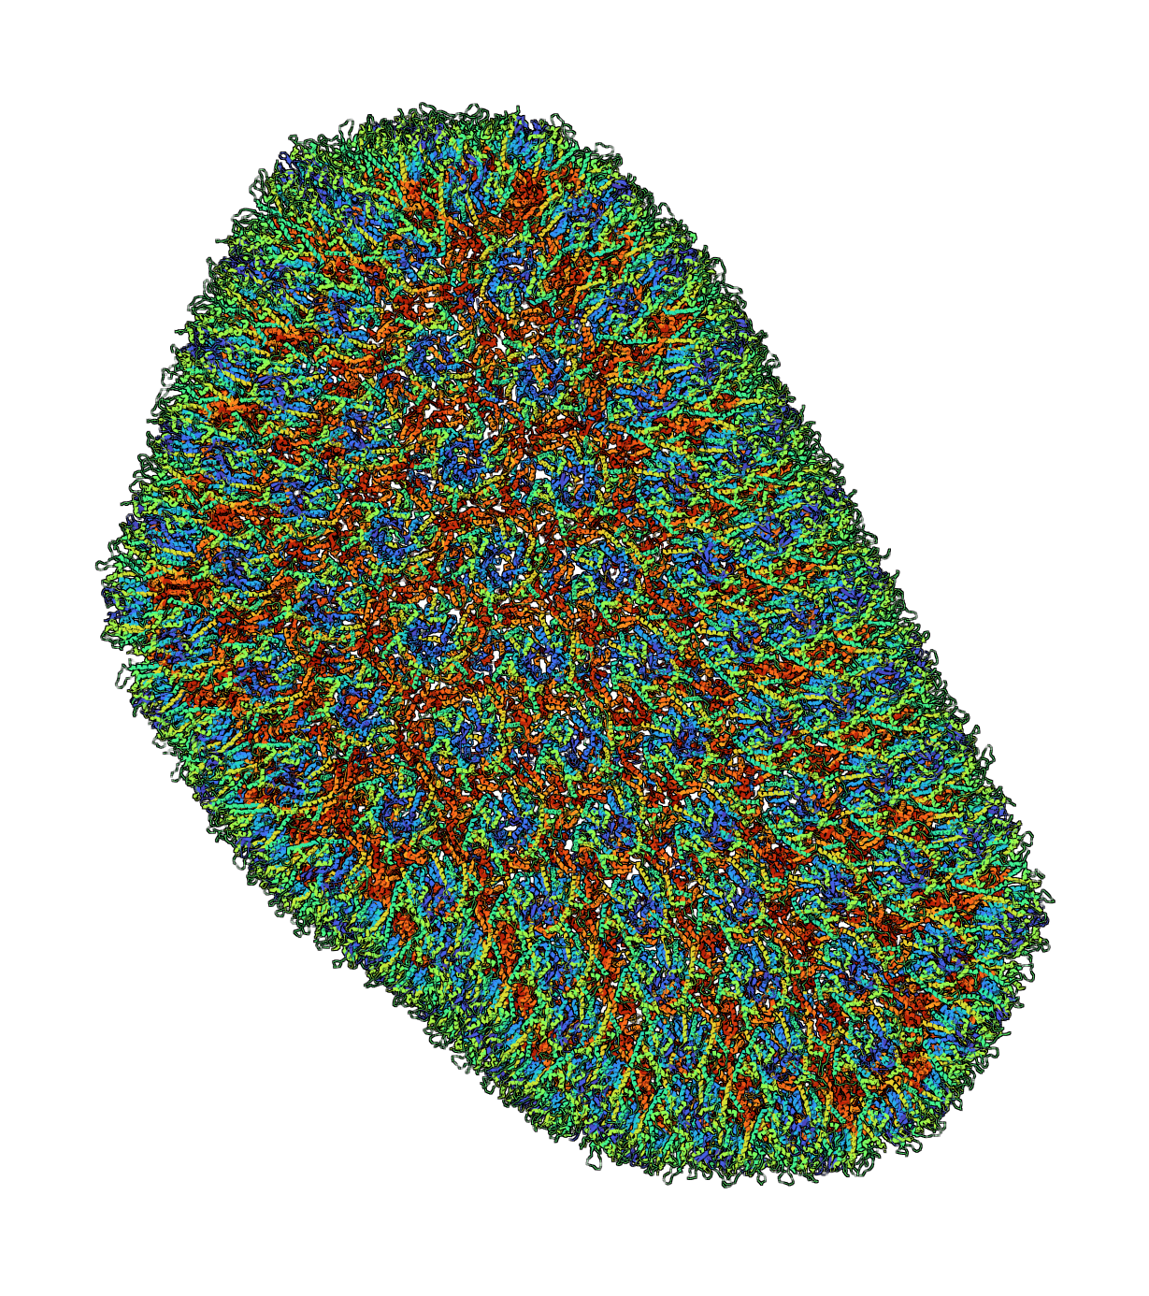
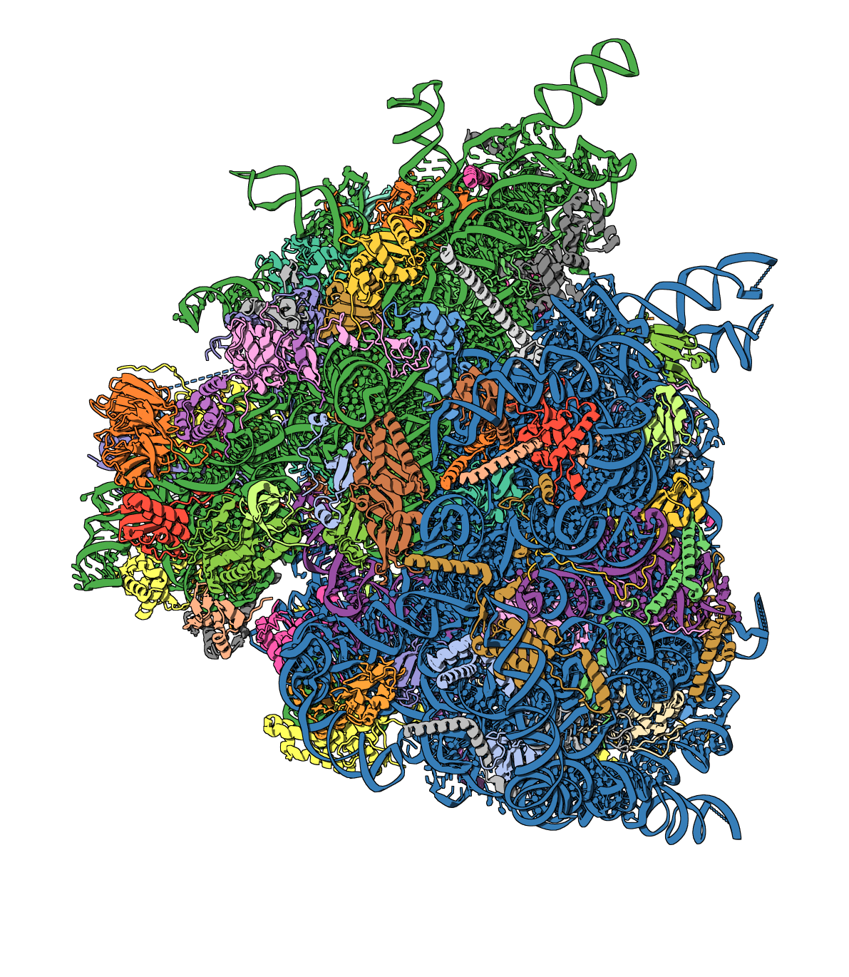
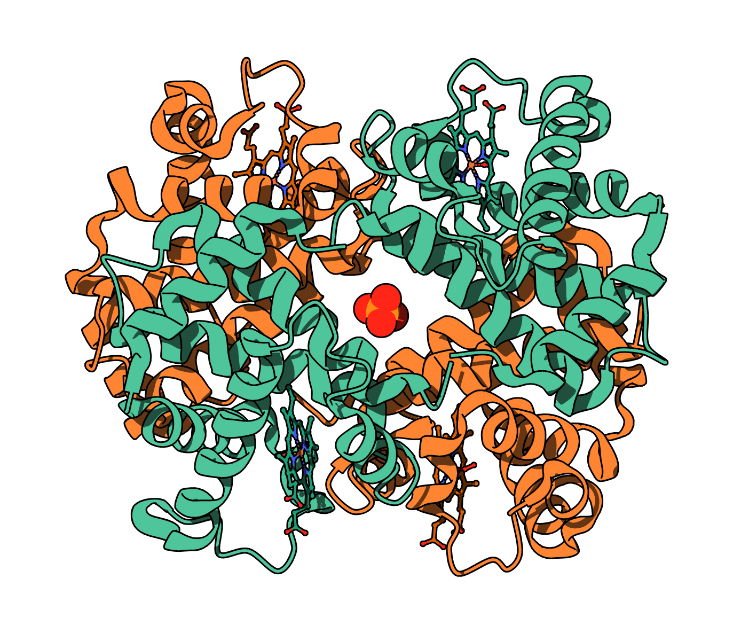
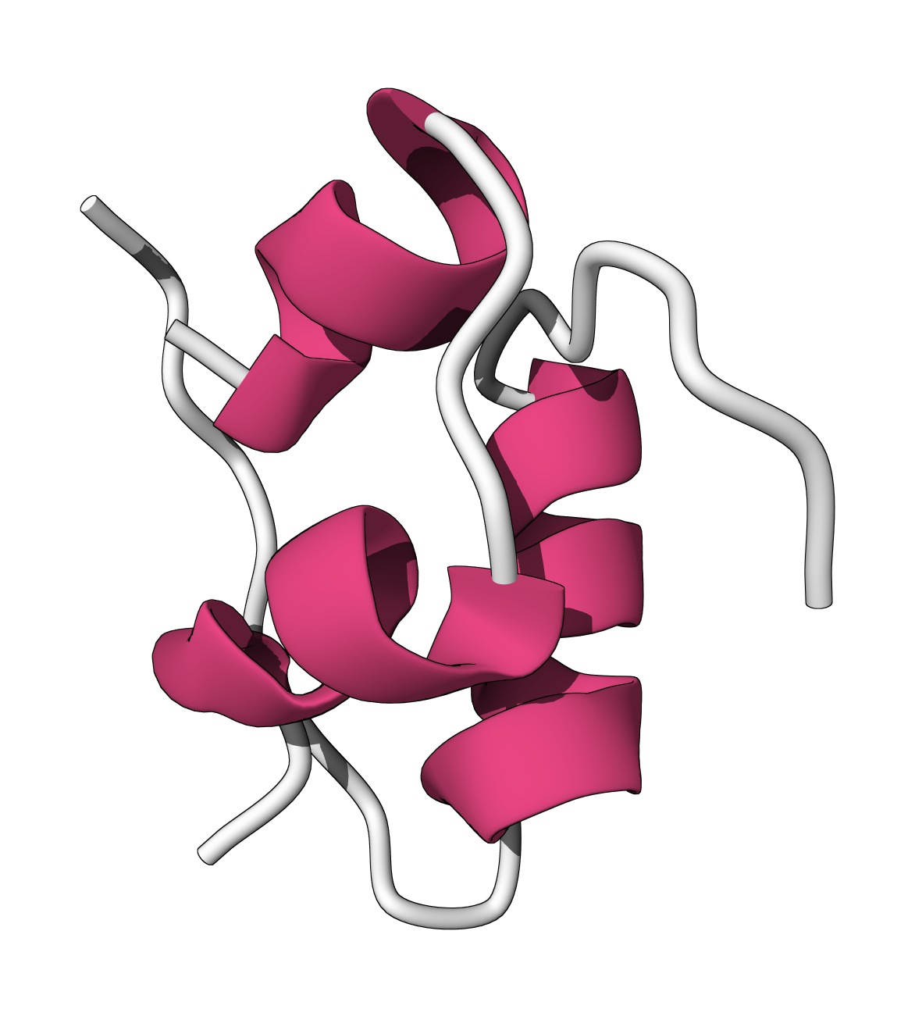
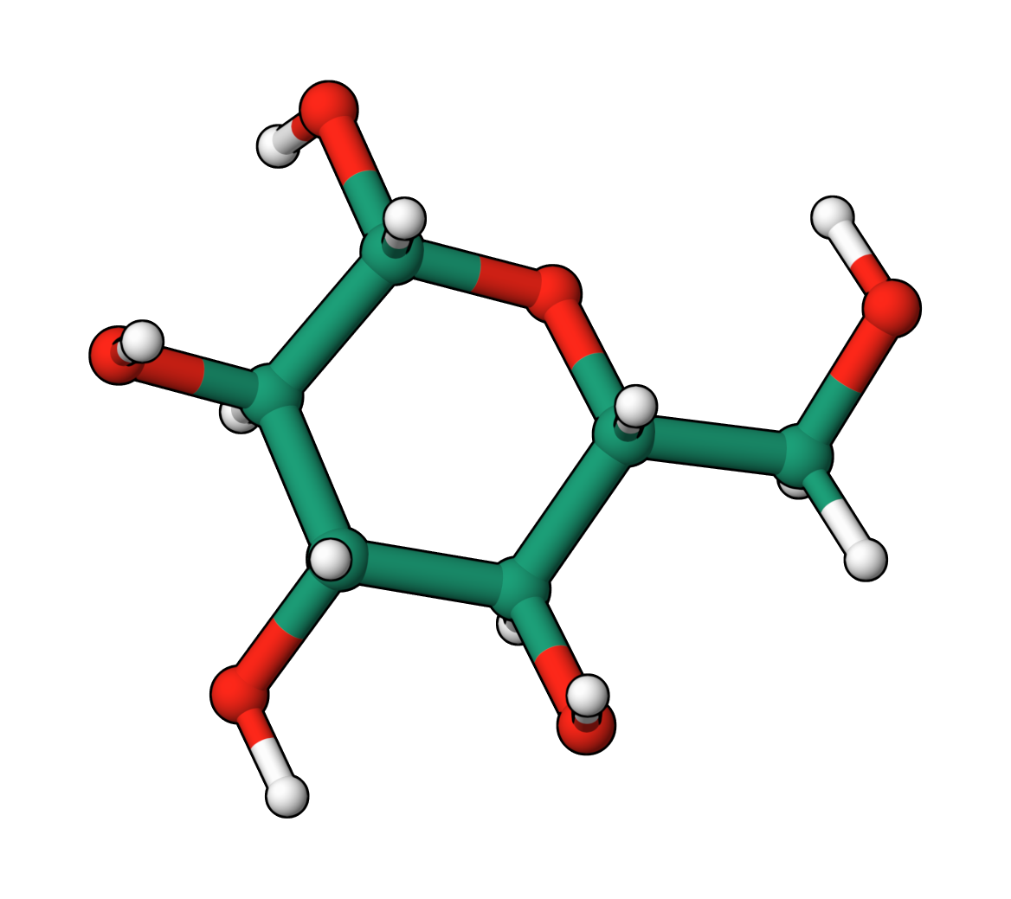
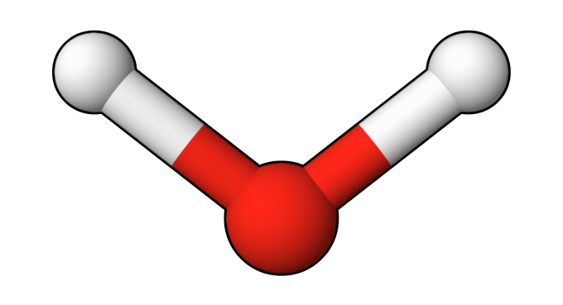
10⁻⁶
length [m]
Molecular Mechanics
mitochondria
10⁻⁷
HIV-1 virus
10⁻⁸
ribosome
Quantum
Chemistry
haemoglobin
10⁻⁹
insulin
QM/MM
glucose
O-H bond
10⁻¹⁰
10⁻¹⁵
10⁻¹²
10⁻⁹
10⁻⁶
10⁻³
10⁰
10³
time [s]
femto-
pico-
nano-
micro-
milli-
light absorption
proton transfer
side-chain flip
2^{ndary} structure formation
protein translation
electron transfer
solute permeation
thermally-driven reactions

Slide 4
10⁻⁶
length [m]
Schrödinger equation
Exact only for H and He
Approximations:
ab-initio: directly derived
semi-empirical and empirical: fitted to experiments
Properties that cannot be isolated: transition & excited states
~100 of atoms, ps motions
Molecular Mechanics
mitochondria
10⁻⁷
HIV-1 virus
10⁻⁸
ribosome
Quantum
Chemistry
haemoglobin
Newtonian Mechanics
Each atom is a bead,
connected by a spring
~100k of atoms, ns - µs
10⁻⁹
insulin
QM/MM
glucose
O-H bond
10⁻¹⁰
10⁻¹⁵
10⁻¹²
10⁻⁹
10⁻⁶
10⁻³
10⁰
10³
time [s]
femto-
pico-
nano-
micro-
milli-
light absorption
proton transfer
side-chain flip
2^{ndary} structure formation
protein translation
electron transfer
solute permeation
thermally-driven reactions

Slide 5
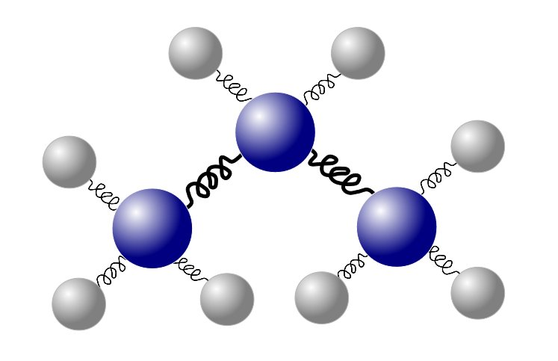
Force Field Methods
A molecule is represented by a set of balls connected with springs
ASSUMPTIONS:
Nuclei and electrons are combined in an atom, represented by a ball
Balls have radius, constant charge and a given softness
Covalent bonds are represented by springs
Springs have an equilibrium length and can vary in stiffness

Slide 6
Force Field Methods
A molecule is represented by a set of balls connected with springs
System’s energy depends on classical (Newtonian) interactions between balls and springs
Interactions are described by pre-assigned parameters = force fields

Slide 7
Force Field Energy
Force Field - set of parameters used in classical mechanical calculations
Potential Energy - the sum of all the interactions in it
E_{FF} =E_{str} +E_{bend} +E_{tors} +E_{VdW} +E_{el}
bonded
non-bonded

Slide 8
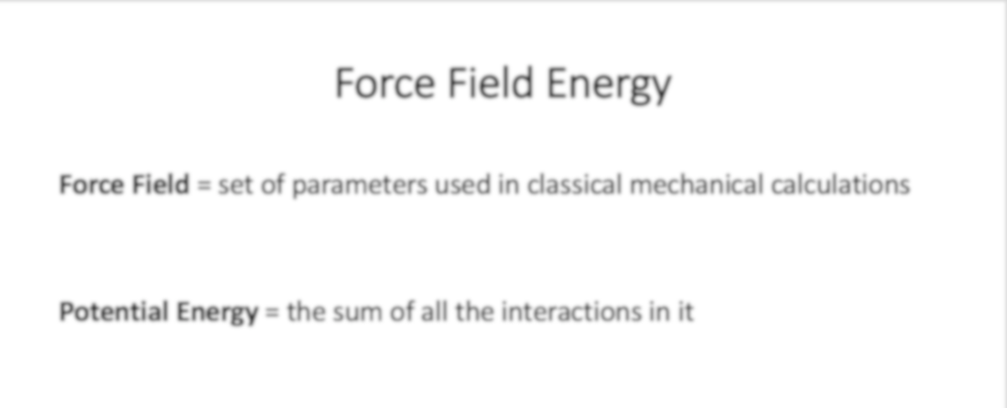
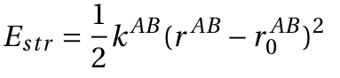
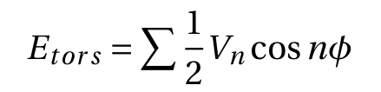
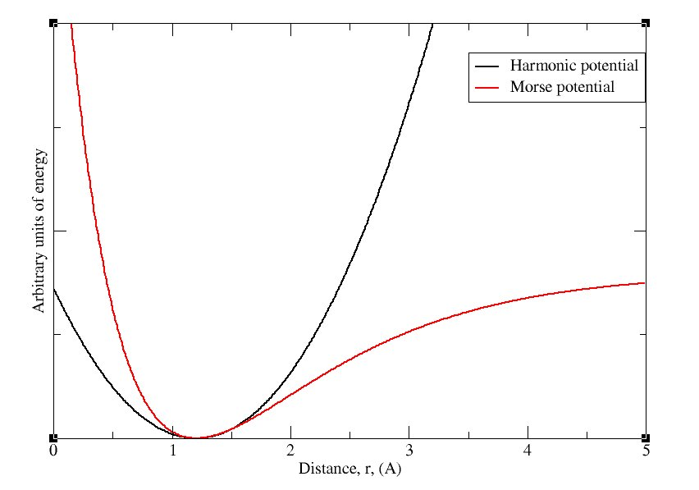
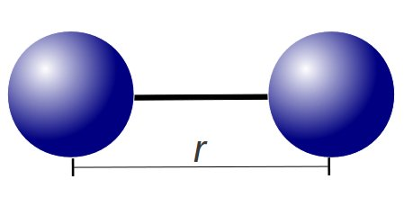
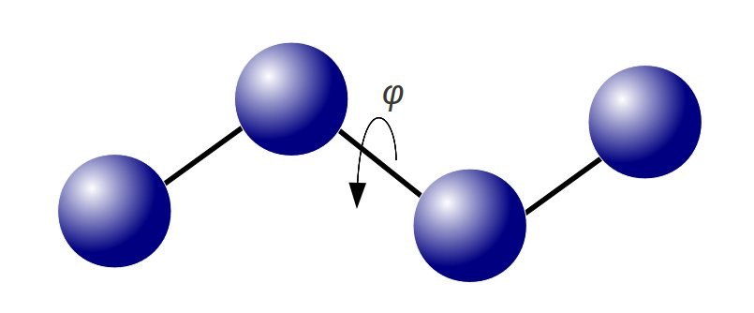
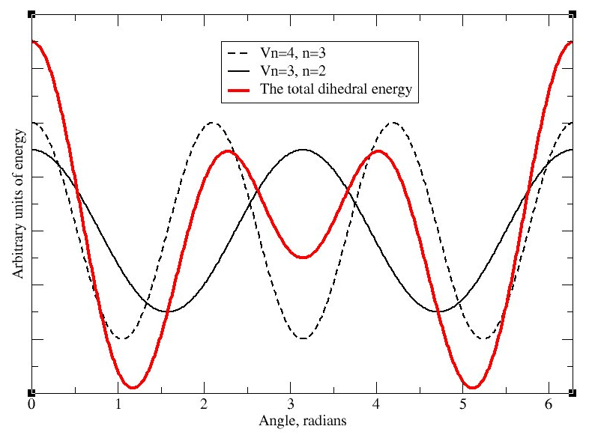
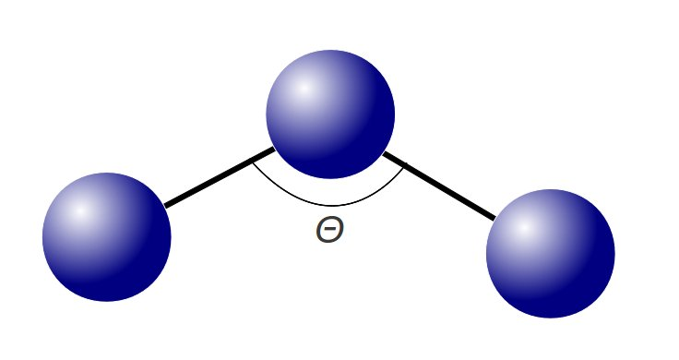
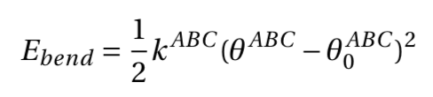
Force Field Energy
Bond Stretch
Torsion
Force Field = set of parameters used in classical mechanical calculations
Potential Energy = the sum of all the interactions in it
E_{FF} =E_{str} +E_{bend} +E_{tors} +E_{VdW} +E_{el}
Bend
bonded
non-bonded
Notes:
Mention strength of interaction, and the constant

Slide 9
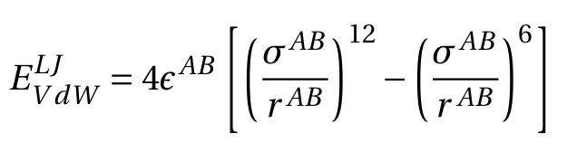
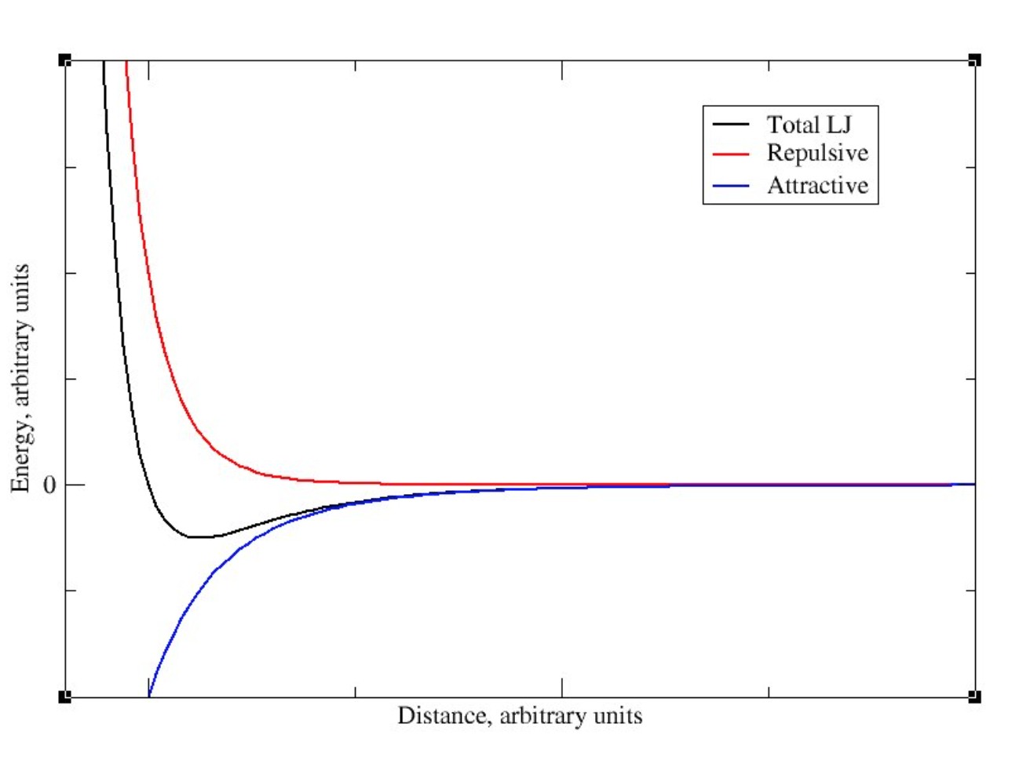

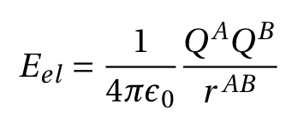
Force Field Energy
Lennard-Jones
Force Field = set of parameters used in classical mechanical calculations
Potential Energy = the sum of all the interactions in it
E_{FF} =E_{str} +E_{bend} +E_{tors} +E_{VdW} +E_{el}
Coulomb
bonded
non-bonded

Slide 10
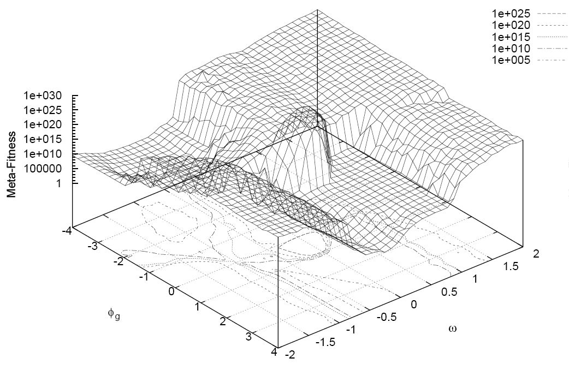
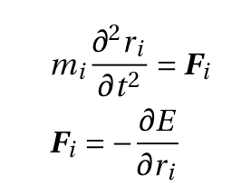
Potential Energy Landscape
Atoms interact => generate forces
Sum of all interactions generates an energy landscape
Energy landscape determines atoms motion
Classical equations of motion are solved step-by-step, by a finite difference algorithm
Newton’s II law of motion is:
m_{i} a
potential energy
position
acceleration
force
mass
time
position

Slide 11
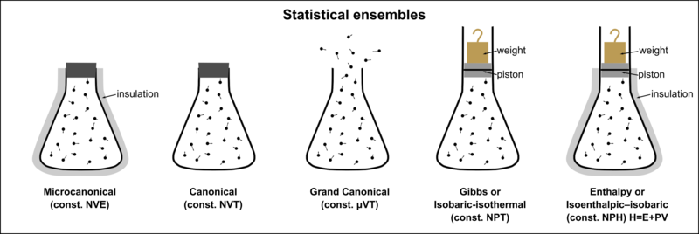
How to control temperature and pressure?
Simulations can replicate a specific thermodynamic ensemble:
Nzjacobmartin, Wikimedia Commons, CC BY‐SA
Addition of equations acting as:
thermostats (scaling atom velocities) – constant T
barostats (scaling positions) – constant P
e.g.: Berendsen, Nose-Hoover, Parrinello-Rahman, …

Slide 12
Is the simulation box finite?
For bulk properties use periodic boundary conditions (PBC)
For boundary effects use wall, PBC in xy-direction, vacuum in NVT, …
…
…

Slide 13
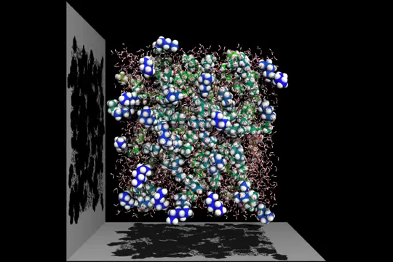
In each simulation timestep…
Set initial conditions for x, v and box size
Compute forces
Compute new x’ and v’ for all atoms
Scale x’ and v’ with thermo/barostat
Update x’ and v’ (with pbc)

Slide 14
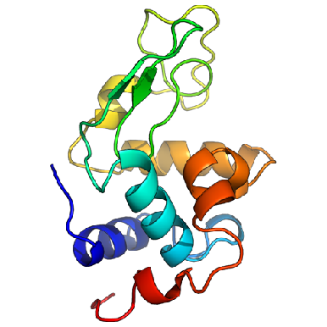
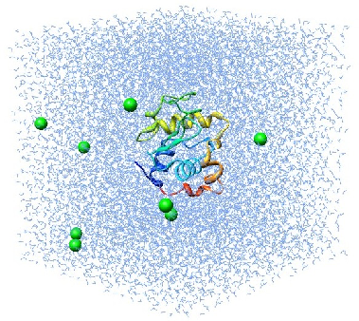
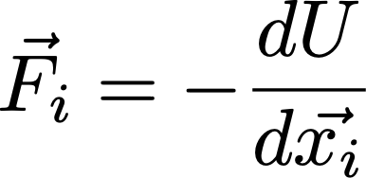
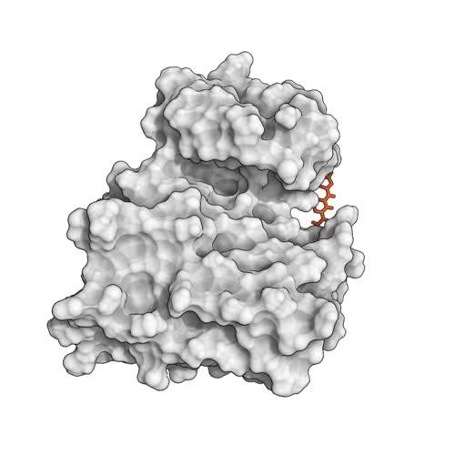
Molecular dynamics require multiple steps for the setup of simulations
Disulphide bridges
Protonation
Solvate in water and add ions
(typically, neutralize the system)
Crystal Waters
Cofactors
Alternative side chains
Solvated protein
Apply forcefield description
NVT/NPT equilibration
Minimize the positions
Equilibrated system
Solvated protein + forcefield
minimized protein
Production simulation
http://www.bevanlab.biochem.vt.edu/Pages/Personal/justin/gmx-tutorials/lysozyme/01_pdb2gmx.html
Levitt, Nature Struct. Biol., 2001

Slide 15
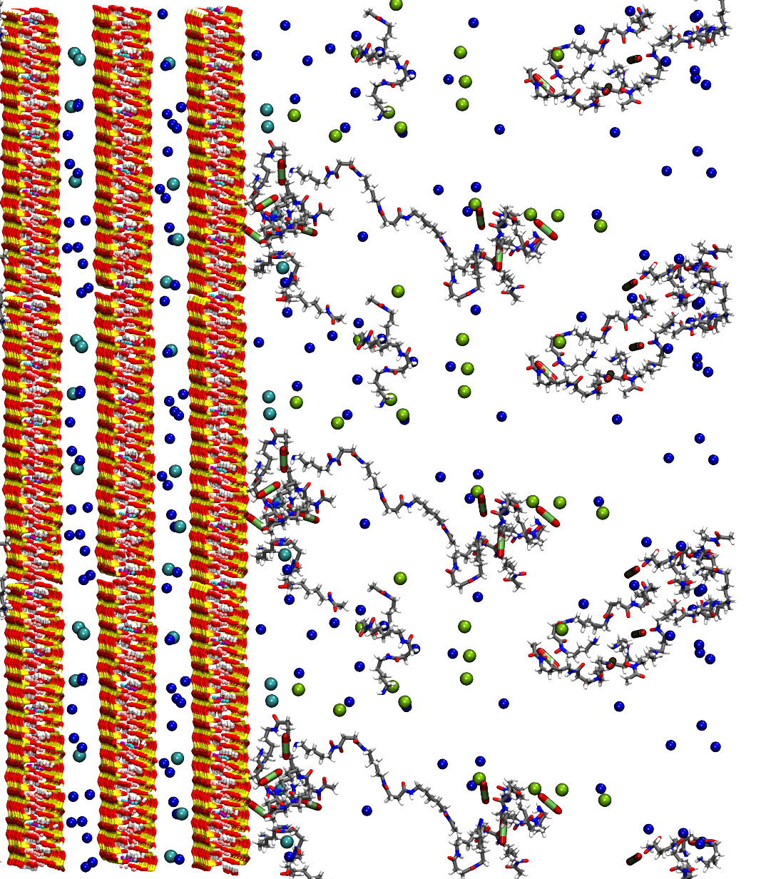
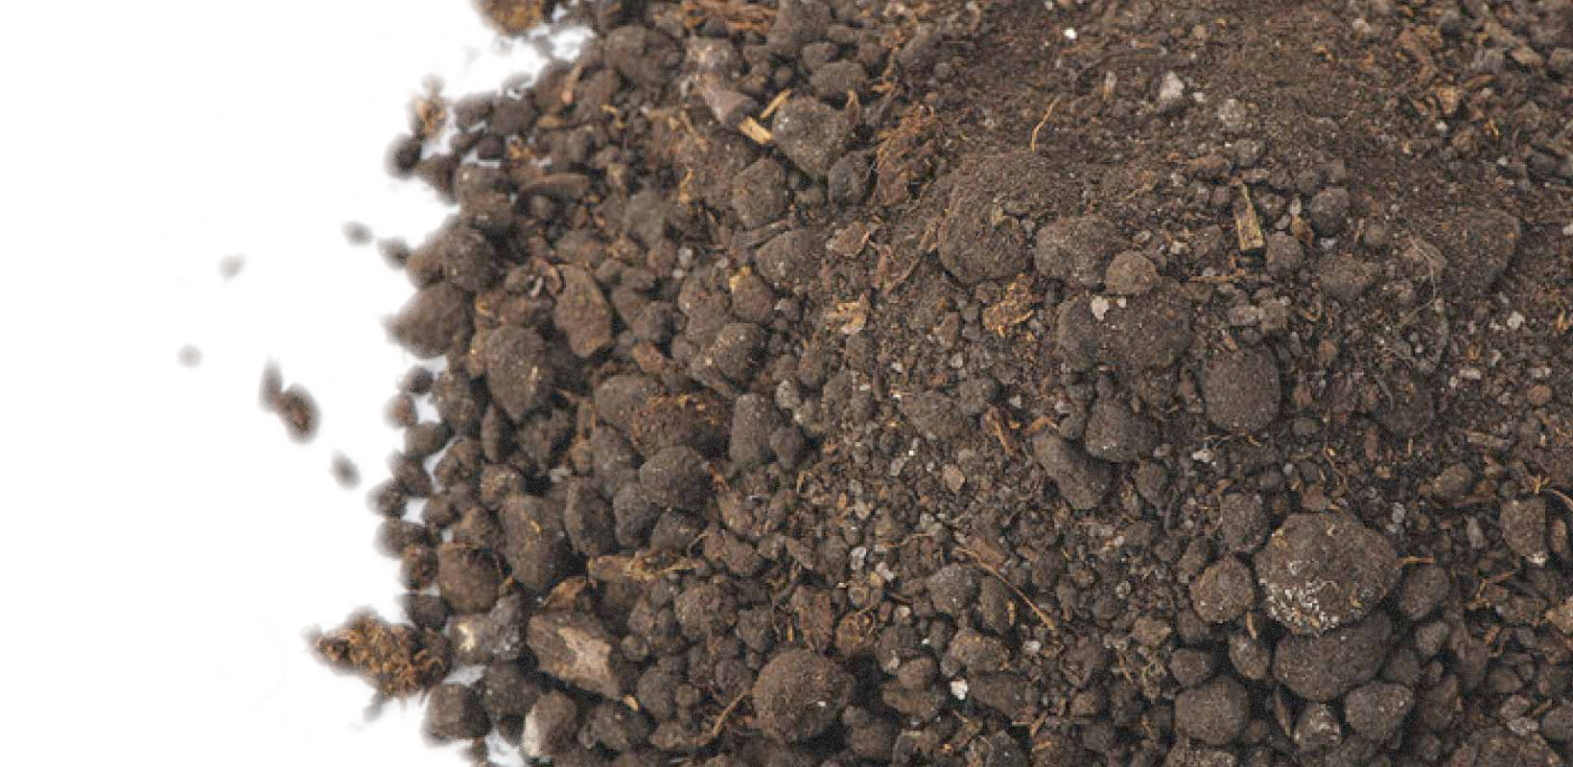
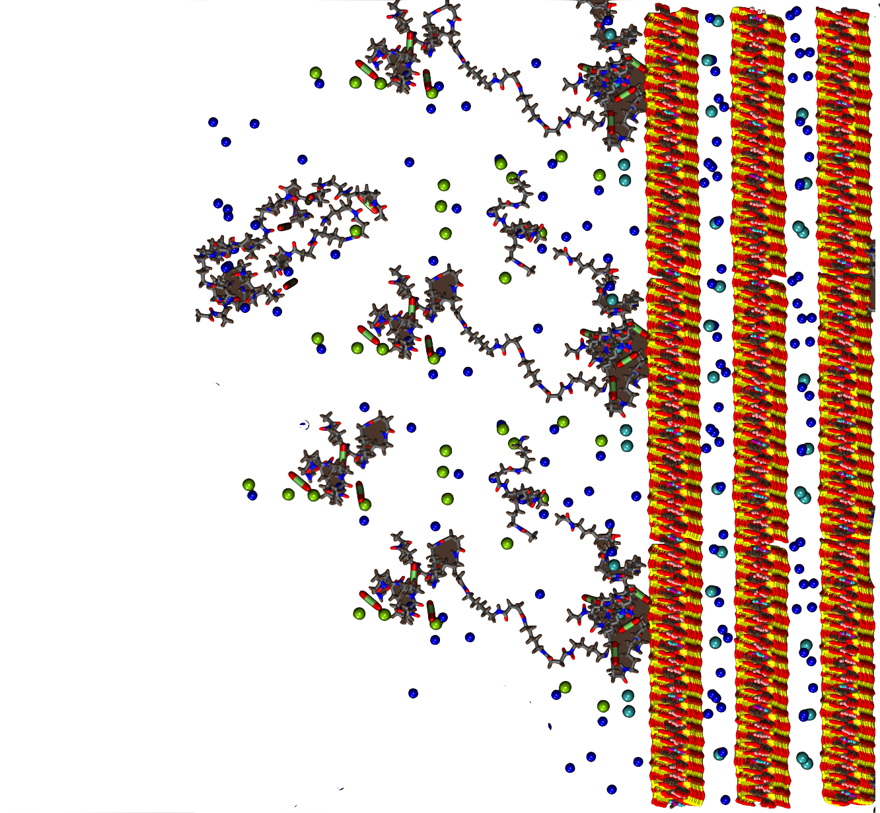
Simulating Layered Materials

Slide 16
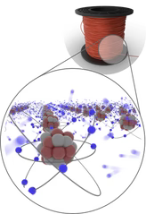
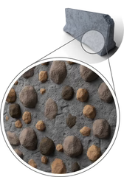
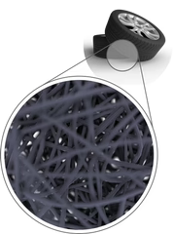
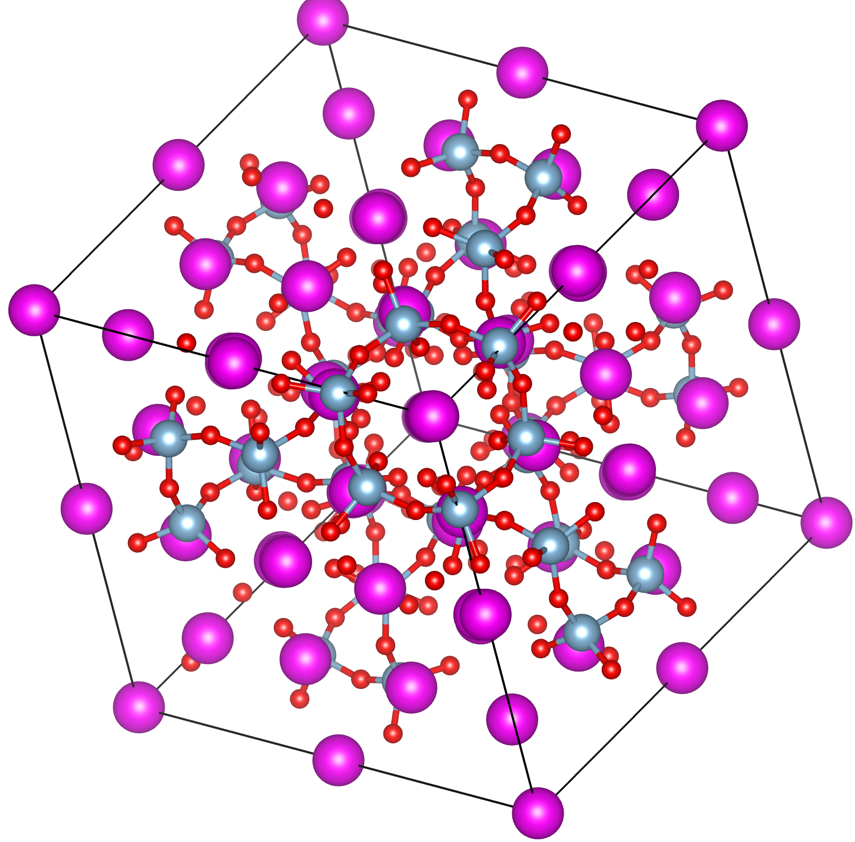
Materials at the Nanoscale
Electric wire
Concrete wall
Rubber tire
Conducting electricity with free electrons of the metals
Cement holds together gravel and sand, creating an aggregate material
Polymer chains give rubber flexibility, while locked together in the rigid structure
From ossila.com

Slide 17
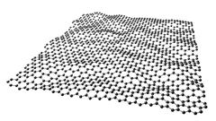
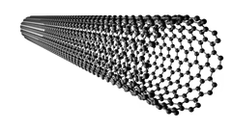
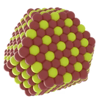
Dimensionality of materials
Nanoscopic dimension – where a scale is in nanometers in size, i.e., structure is at an atomic level.
Nanoscopic Dim. No. | Classification | Example
0 | Bulk | Anything you can see by eye
1 | 2D (nanosheet) | Graphene
2 | 1D (nanotube or nanowire) | Carbon nanotube
3 | 0D (nanoparticle) | Quantum dot
2D - graphene
1D - nanotube
0D – quantum dot
From ossila.com

Slide 18
Why are layered materials of interest?
Mechanical properties: weak van der Waals interactions between planes + strong covalent bonds in the plane
High surface areas per weight/volume: more active chemical sights for adsorption or reactions
Confinement of electrons in a 2D plane: effecting its electronic and optical properties

Slide 19
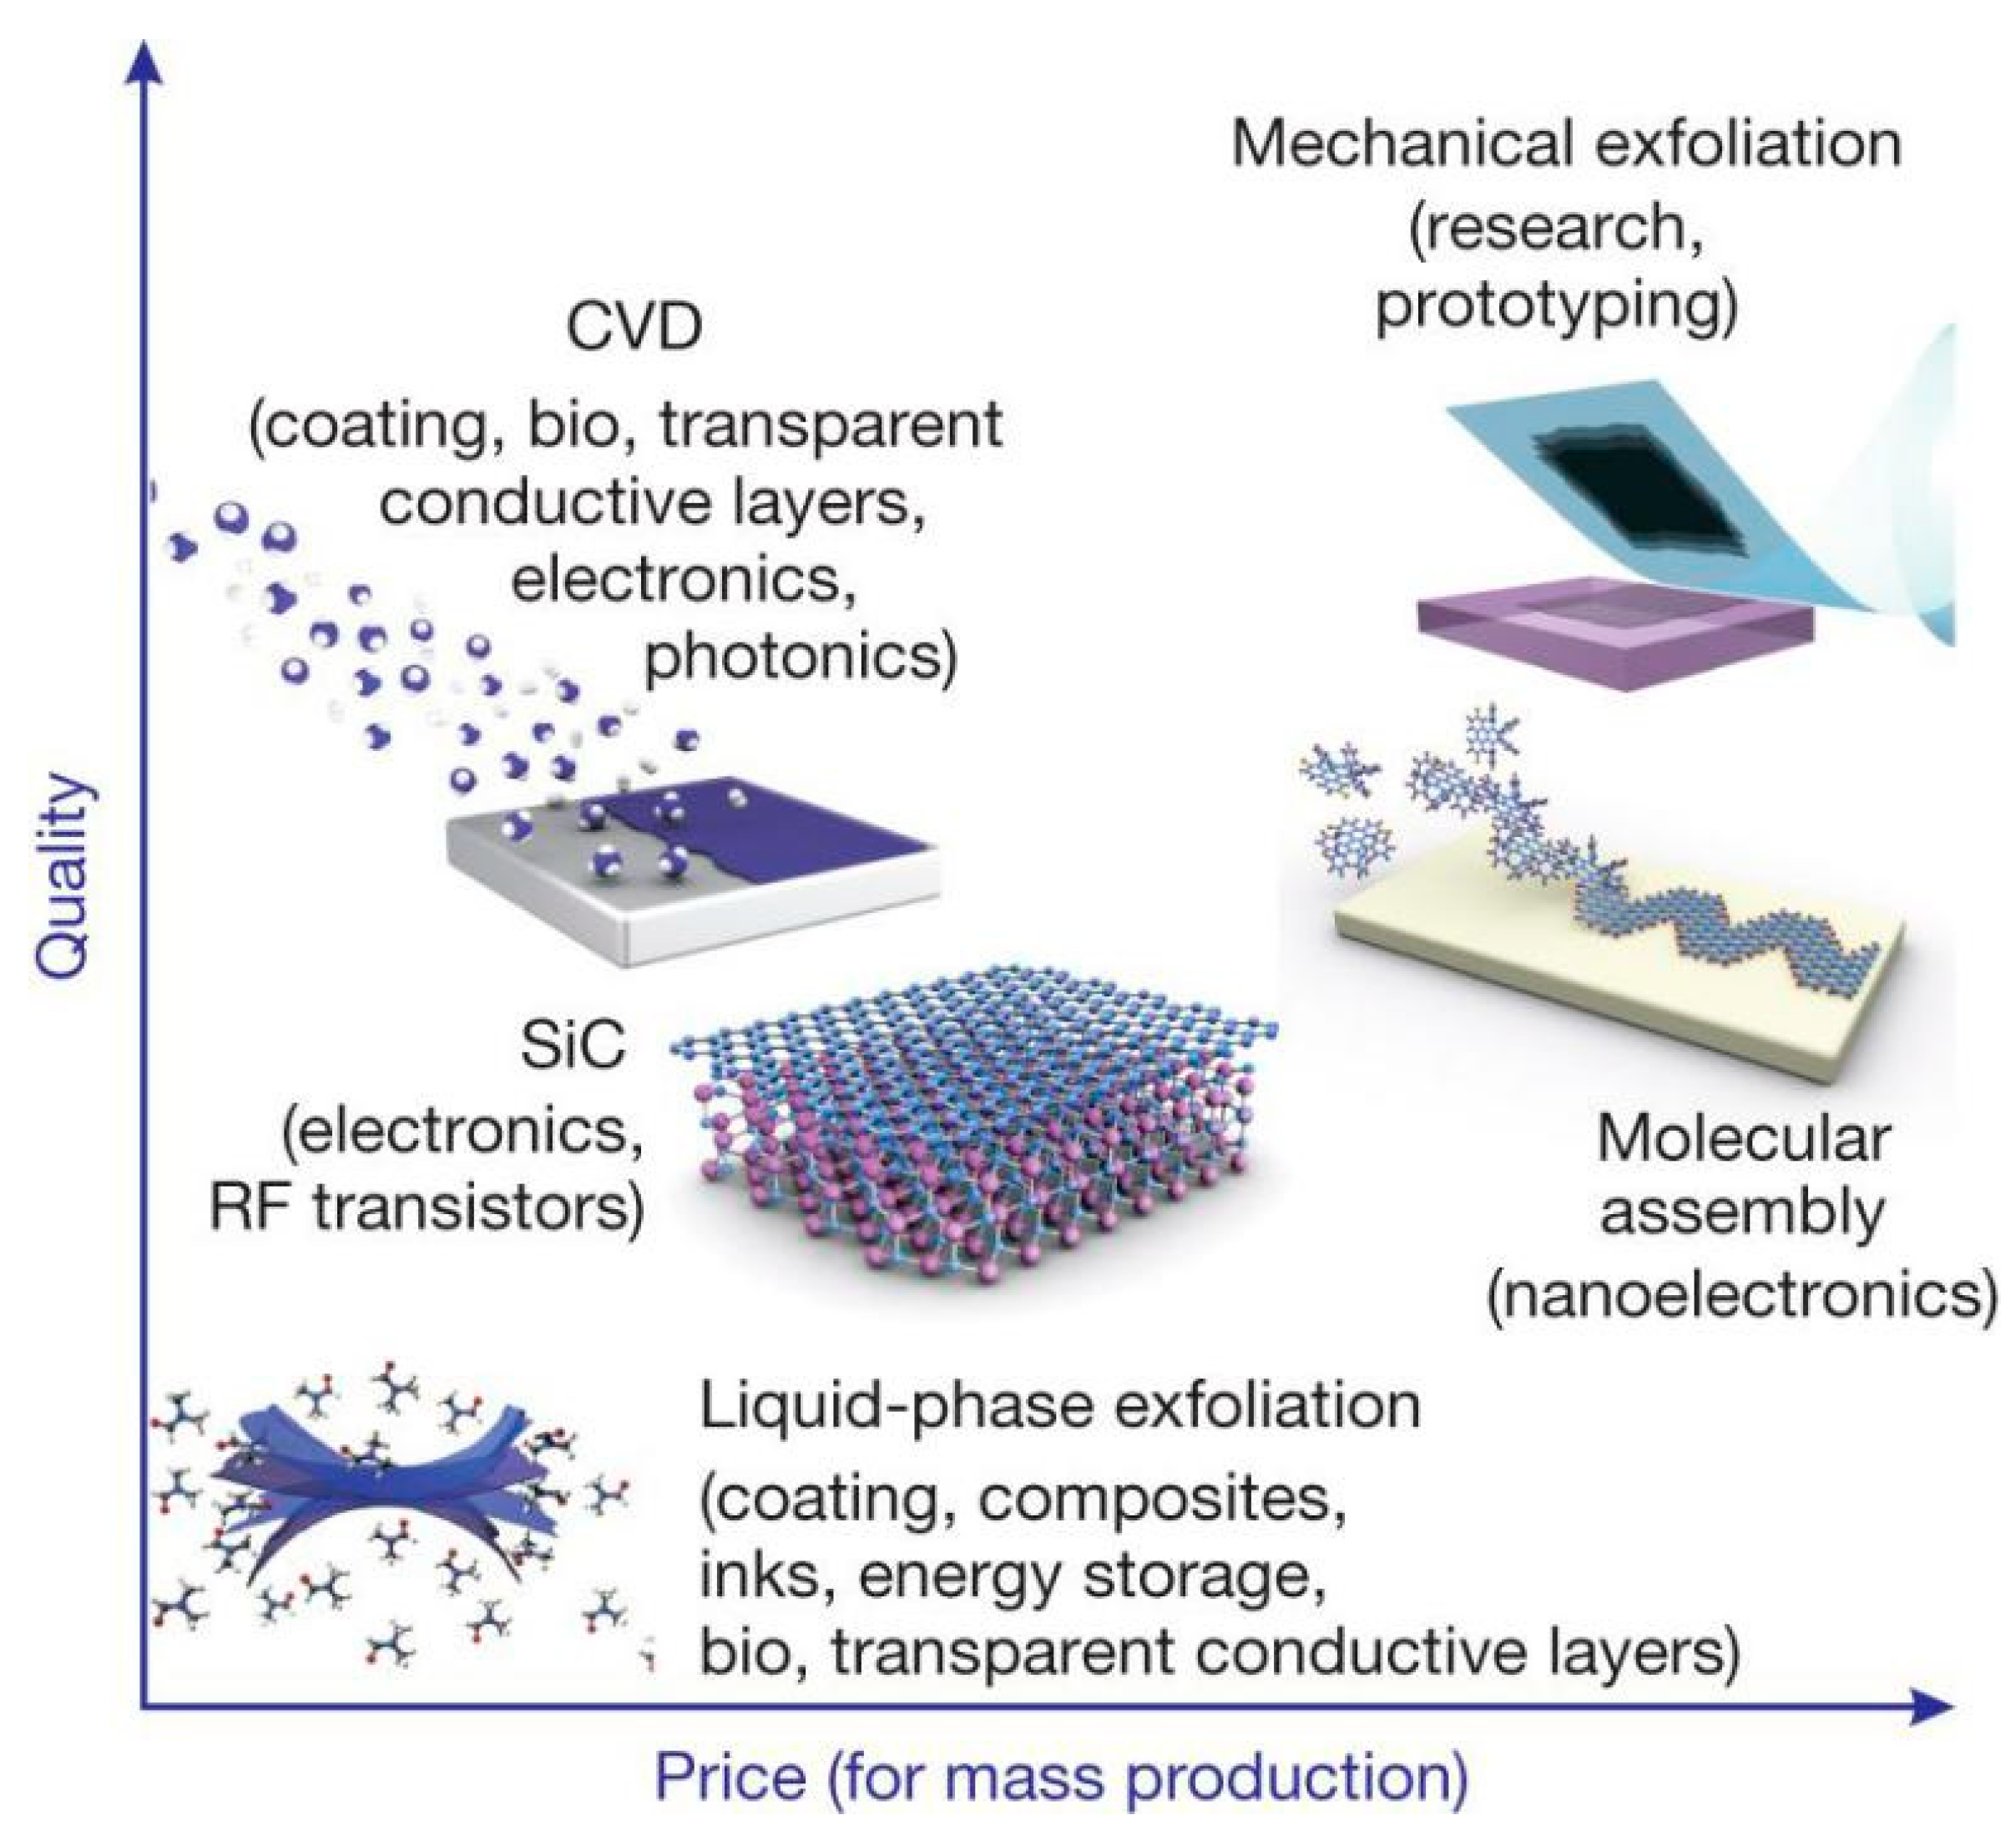
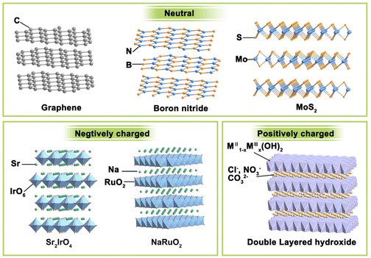
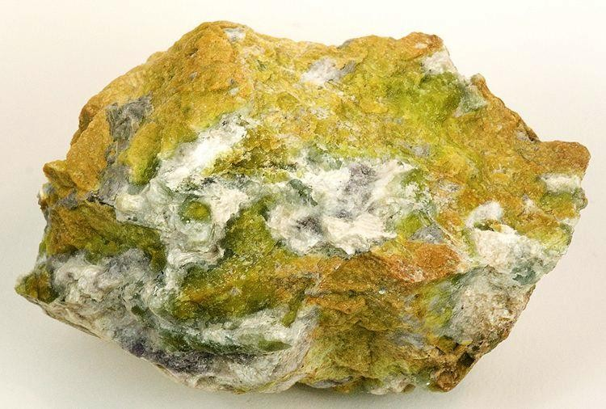
Fabricated
https://doi.org/10.3390/nano8110942
Natural
https://doi.org/10.1039/D3GC01822A
Layered double hydroxide
Rob Lavinsky, iRocks.com – CC-BY-SA-3.0

Slide 20
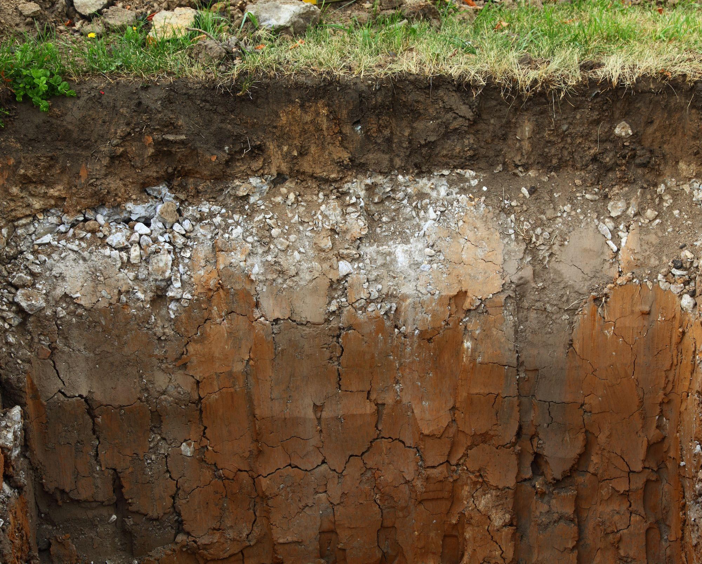
The Soil

Slide 21
The Soil
Organic Material 5%
Air
25%
Minerals 45%
Water
25%
By Volume

Slide 22
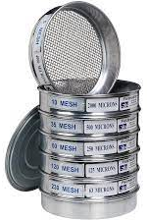
Minerals in the Soil
Organic Material 5%
Minerals 45%
Notes:
sieve

Slide 23
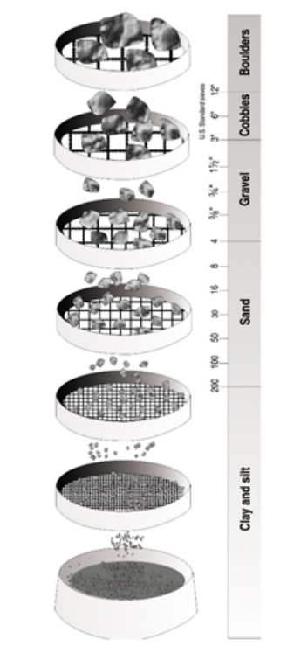
Minerals in the Soil
Organic Material 5%
Minerals 45%
Sand
40%
Silt
40%
Clay
10%

Slide 24
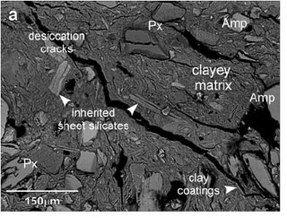

Minerals in the Soil
Organic Material 5%
Minerals 45%
SEM of a Soil Sample from DOI: 10.1127/0935-1221/2011/0023-2084

Slide 25
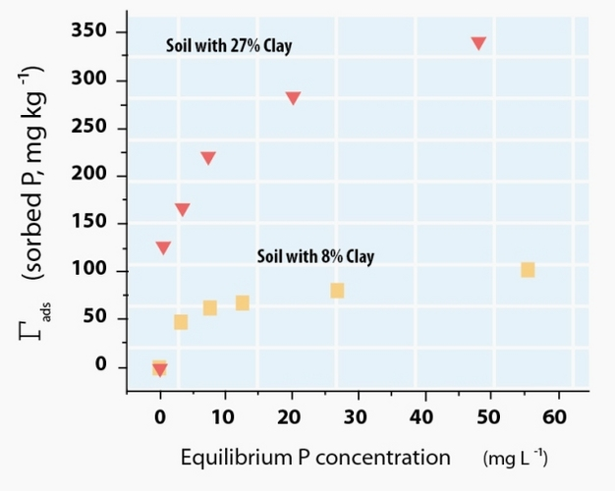
Why Clay?
Phosphorus sorption by different soils
SEM of a Soil Sample from DOI: 10.1127/0935-1221/2011/0023-2084
Figure from A Thompson & KW Goyne (2012) Nature Education Knowledge

Slide 26

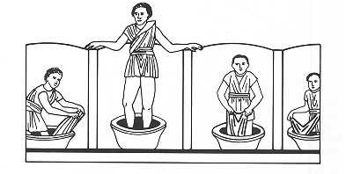
Why Clay?
Fuller’s Earth or Bleaching Earth
pre-3000 BC
Mesopotamia, Egypt & Greece
Phosphorus sorption by different soils
A fuller treading the cloth, others rinsing
Smectite – group of swelling clays
Greek smectis (fuller’s earth) and smechein (wipe off, clean)
Read more: K Beneke & G Lagaly (2002). From Fuller’s earth to bleaching earth: a historical note. ECGA Newsletter, 5
Figure from A Thompson & KW Goyne (2012) Nature Education Knowledge

Slide 27
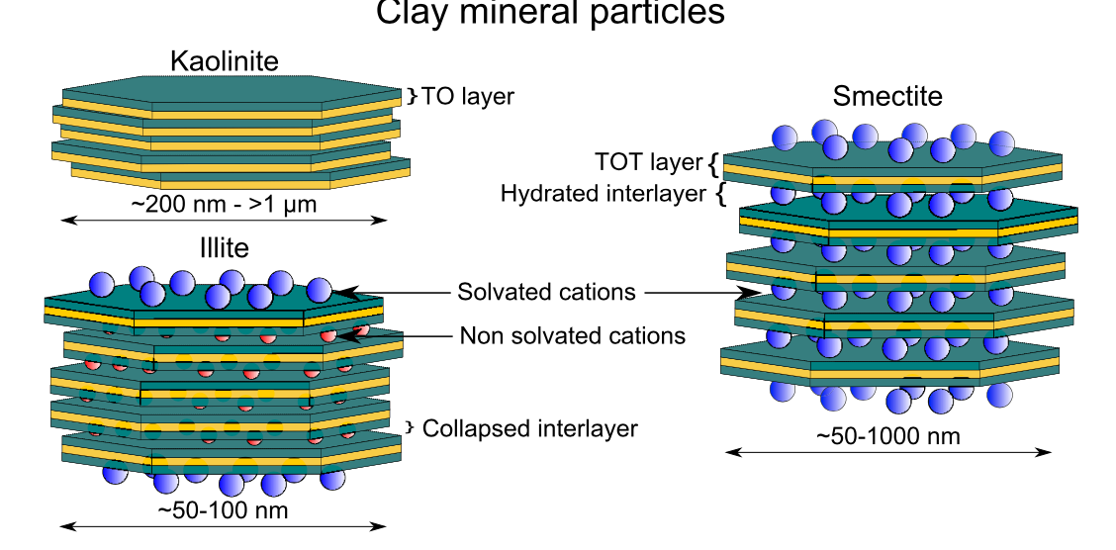




What is Smectite?
Clays have a variety of sorption behaviors for many components, all driven by their atomic-level structures
T
O
T
Figure from Jaynes & Boyd (1991). Soil Sci. Soc. Am. J. 55
Figure from Developments in Clay Science, Vol. 6C. DOI: 10.1016/B978-0-08-100027-4.00001-2
Low-charge smectite
High-charge smectite

Slide 28

Clay minerals for pollution management:
https://doi.org/10.1007/978-981-99-2544-5_1

Slide 29
Clay minerals for pollution management:
https://doi.org/10.1007/978-981-99-2544-5_1

Slide 30







How do I start modeling clay mineral system?
Replicate in xy -plane
Add space in z-direction
Add organics and/or ions
2D slab of a clay
Unit cell of a clay mineral
1. Prepare topology
2. Solvate
1 - Equilibration
2- Production
Energy minimisation
Charge
balance

Slide 31

Questions?

